Slide 1


Kotlin
Jvm
Kerem Akkaya

Slide 2
Kotlin Powers
Concise
Interoperable
Tool Friendly
Ant
Maven
Gradle

Slide 3
Server Side Development
Spring supports from version 5.0
Spring Boot
Vert.x for reactive Web Applications
Amazon Web Services
Google Cloud Platform
Heroku
HttpServlet

Slide 4
Android
JDK 6 support on Kotlin
Android Studio Plugin
Performance
Inline functions
Lambdas
Incremental Builds Faster
Kotlin Koan

Slide 5
Javascript
DOM elements
Graphics such as WebGL
Server-side technology
Node.js

Slide 6
Native Interoperability
Currently in development ☹
Without any VM
IOS, embedded targets
Target Platforms
Windows (x86_64 only)
Linux
Mac OS
iOS
Android

Slide 7
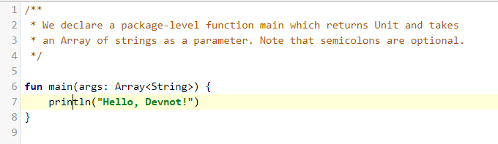

Hello World - Main

Slide 8
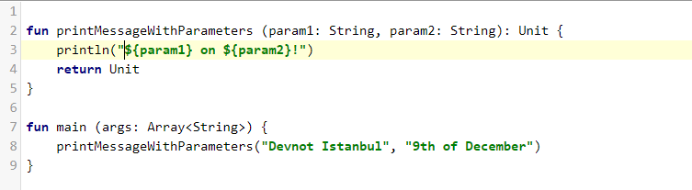
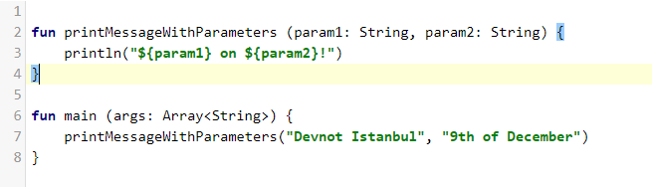

Hello World – Call Function

Slide 9
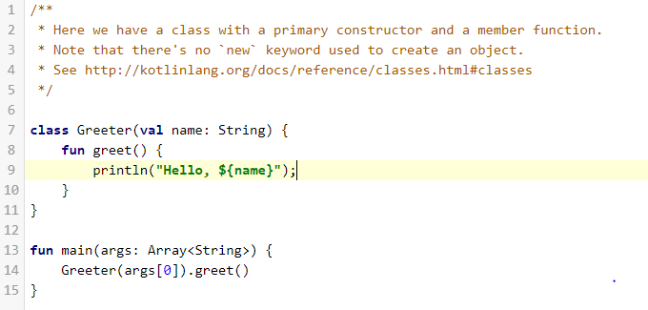

Hello World - Class

Slide 10
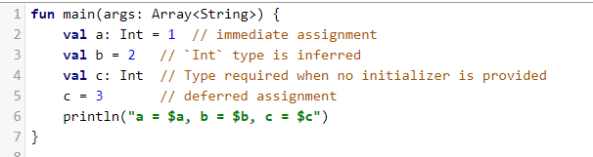

Variables Assign-once (read-only)

Slide 11
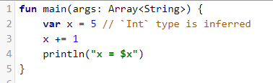

Variables - Mutable

Slide 12
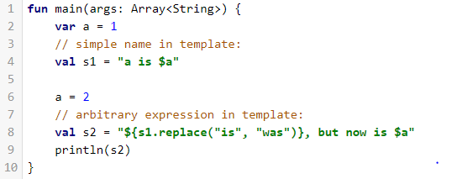
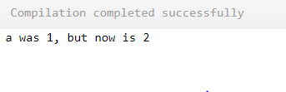
String Templates

Slide 13
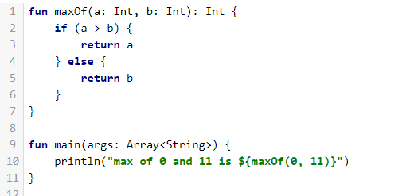
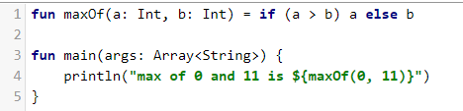

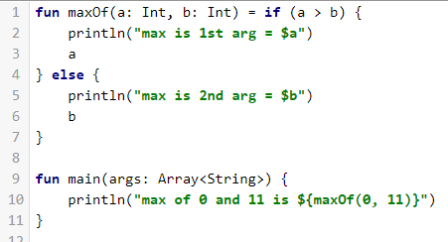

Conditional Expressions - If

Slide 14
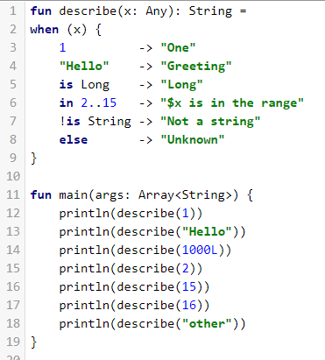
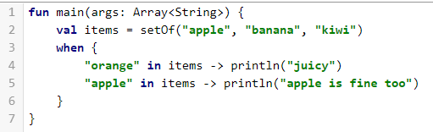

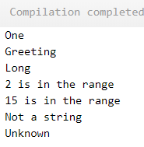
Conditional Expressions – When (No Switch)

Slide 15
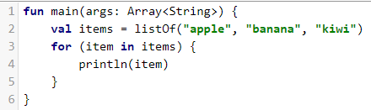

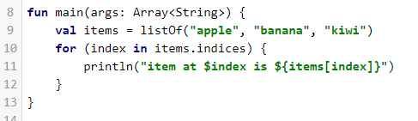
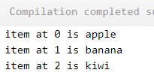
Loops - For

Slide 16
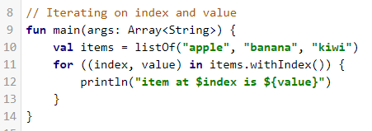
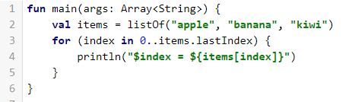
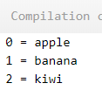
Loops - For

Slide 17
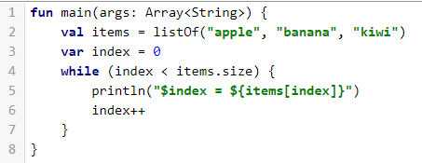
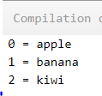
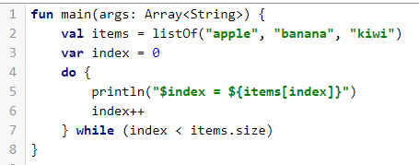
Loops – While and Do

Slide 18
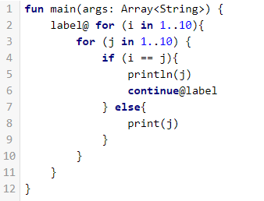
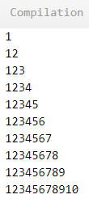
Return, break, continue

Slide 19

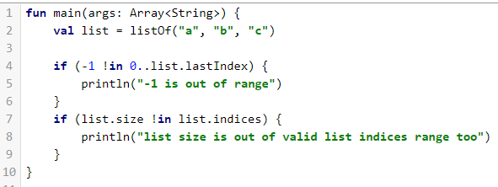
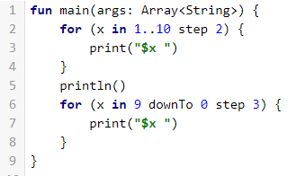
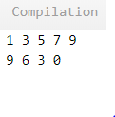
Ranges

Slide 20

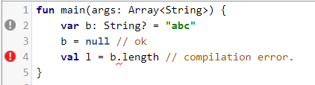
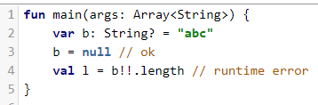
Nullables - ?

Slide 21
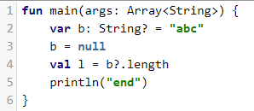

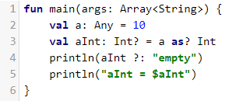

Safe Calls – Safe Casts

Slide 22
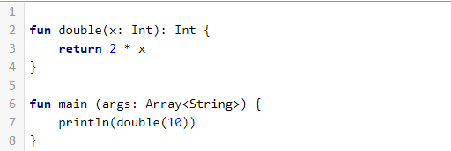

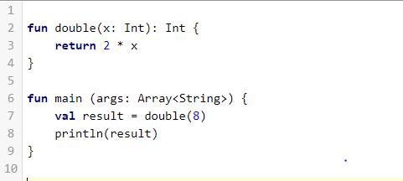

Functions - fun

Slide 23
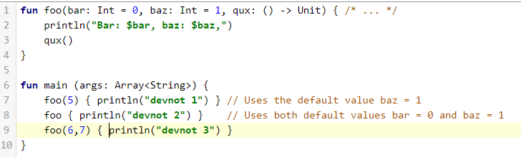
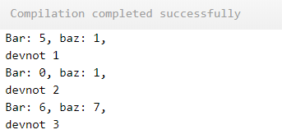
Functions – Default Arguments

Slide 24
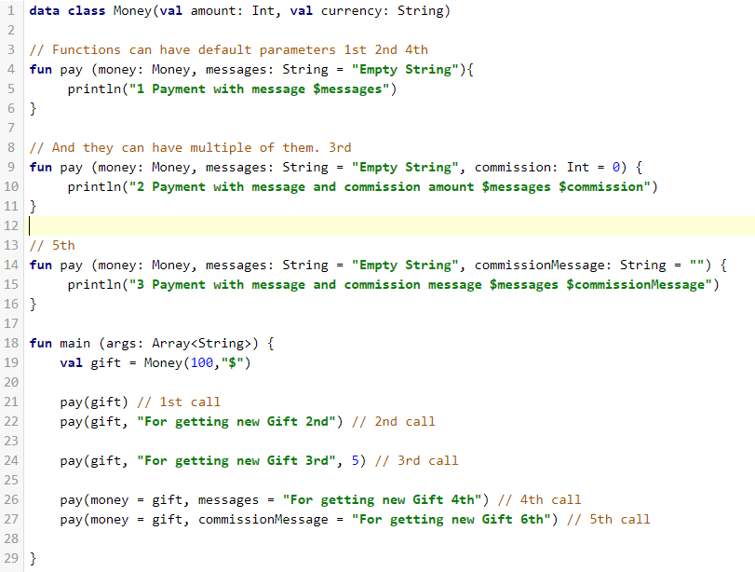
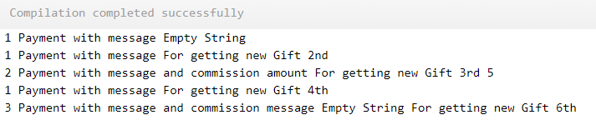
Functions - Default Arguments

Slide 25
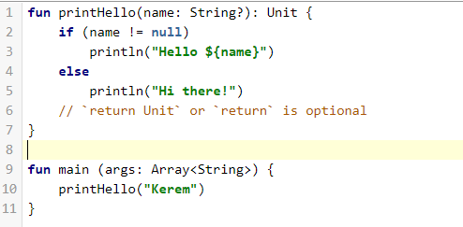

Unit-returning functions

Slide 26
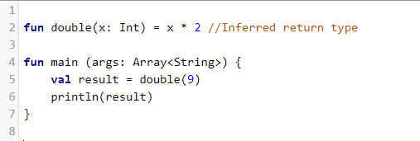

Single-Expression functions

Slide 27
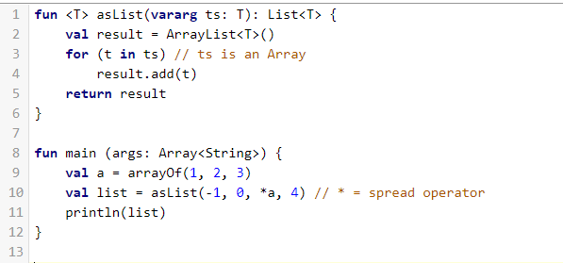

Variable Number of Arguments

Slide 28
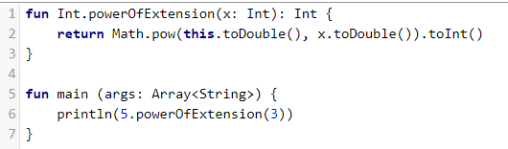

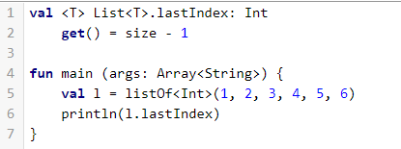

Extension Function

Slide 29
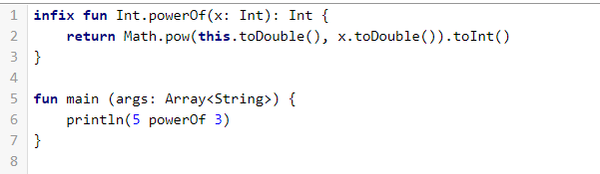
Infix Operator

Slide 30
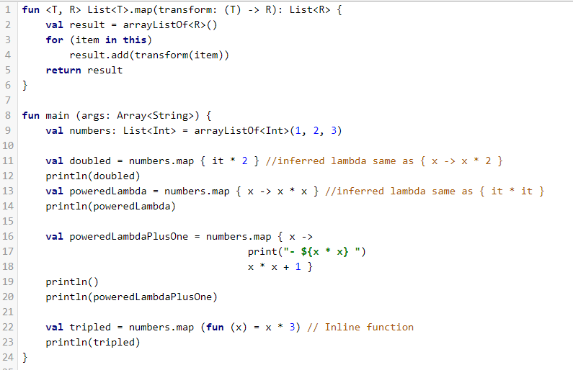
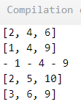
Lambda Functions

Slide 31
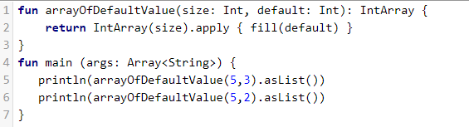

Builder-style usage of methods that return Unit

Slide 32
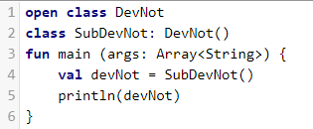
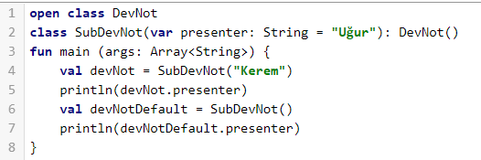

Classes

Slide 33
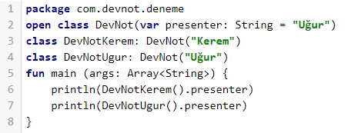

Classes - Constructors

Slide 34



Classes Constructors

Slide 35


Getters and Setters

Slide 36

Getters and Setters

Slide 37

Data Class

Slide 38


Object Oriented Support

Slide 39



Interfaces

Slide 40

Interfaces – Resolve Override Conflicts

Slide 41


try/catch expression

Slide 42


With

Slide 43



Object Expressions

Slide 44

Object Expressions

Slide 45


No static - Companions

Slide 46


Java vs Kotlin
Kotlin:
Java:

Slide 47


Java vs Kotlin
Kotlin:
Java:

Slide 48
References
https://kotlinlang.org
https://try.kotlinlang.org
https://developer.android.com/samples/index.html?language=kotlin
https://developer.android.com/kotlin/resources.html

Slide 49

Thanks - Questions
Introduction To Kotlin
Kerem Akkaya

